Slide 1


Bucharest Big Data Meetup
Tech talks, use cases, all big data related topics
March 14th meetup
6:30 PM - 7:00 PM getting together
7:00 - 8:00 Intro to Kubernetes – from containers to orchestrating the world, Alex Sirbu, R&D Team Lead at Lentiq, a Bigstep Company
8:00 - 8:30: Pizza and drinks sponsored by Netopia.
Sponsored by
Organizer
Valentina Crisan

Slide 2

Intro to Kubernetes -
from containers to orchestrating the world

Slide 3

Contents
Who am I? Containers Container Orchestrators Kubernetes - What? Why? How? Extending Kubernetes Kubernetes and Big Data Quick demo Q&A

Slide 4
Who am I?
Alex Sirbu
R&D Team Lead @ Lentiq
Building the EdgeLake – flexible cloud data lake service
Built on Kubernetes!
Before – R&D Team Lead @ Bigstep, working on bare metal cloud orchestrator

Slide 5
Containers

Slide 6
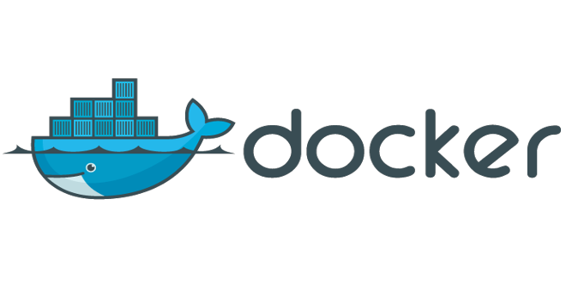
Container - What's in a name?
Coming from the shipping industry
Caused aquatic theme for domain

Slide 7
Shipping containers
Portability - can be used on any of supported types of ships
Wide variety of cargo that can be packed inside
Standard sizes - standard fittings on ships
Many containers on a ship
Isolates cargo from each other

Slide 8
Translated to software
Portability - can be used on any supported system (system with container execution environment)
Wide variety of software that can be packed inside
Standard format
Many containers to a physical node
Isolates execution of one container from another

Slide 9
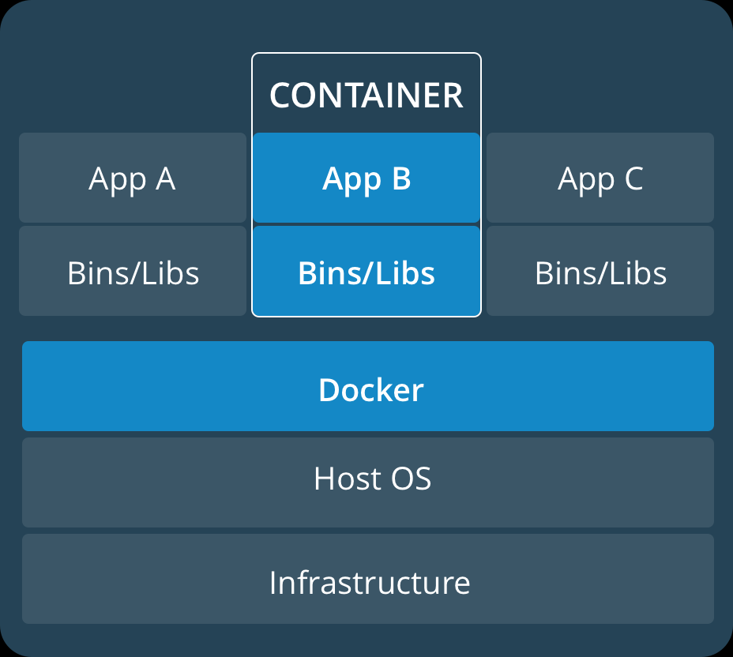
What is a container?
way to pack code and dependencies together
can run anywhere
execute multiple containers to a physical machine

Slide 10
Sounds familiar?
same concept as virtual machines
pack OS and software together, to run in isolated instances
can run anywhere the specific hypervisor runs
multiple VMs to a physical machine

Slide 11
How do VMs work?
hypervisor = layer between VM and kernel
emulates system calls
allows multiple types of operating systems on a machine (Windows on Linux)
overhead for hypervisor

Slide 12
Containers on the other hand ...
only contain application and application-related libraries and frameworks, that run on the host machine's kernel
smaller
lower overhead
differences in OS distributions and dependencies are abstracted - same kernel

Slide 13
Working together, not against each other
Windows on Linux possible only with VMs
older software needs to be adapted to be run as containers (and won't)
usage of VMs as a medium for containers (better isolation and easier scaling)

Slide 14
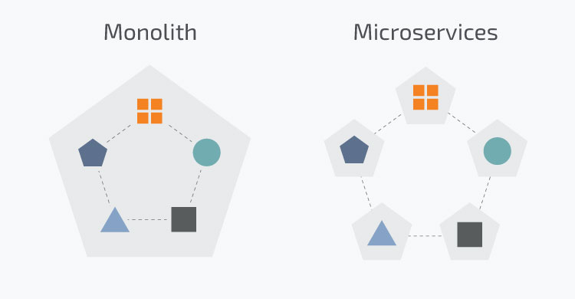
Greater modularity in software
Monolithic application → independent services that interact (microservices)

Slide 15
Containers empowering microservices
quicker start times -> easy to prototype or scale
allow work to be done independently on modules -> independent releases for components (take care of interfaces)
isolated and abstracted runtime environments, that can be tailored for each module
shared runtime environment, for heterogenous applications

Slide 16
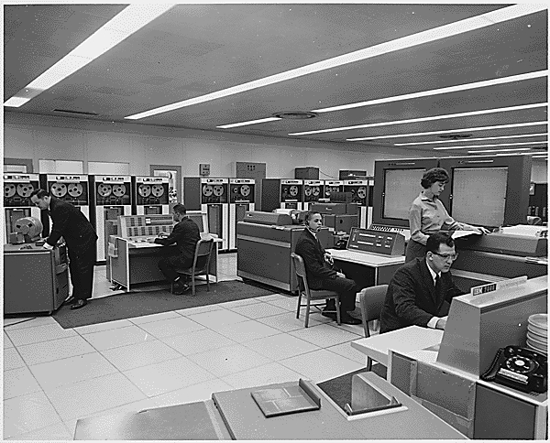
Containers history – early days
need for resources to be shared among many users -> multiple terminals connected to the same mainframe
main problem - execution can cause the main computer to crash -> down for everybody

Slide 17
Containers history – isolating more and more
Chroot – 1979 – change root directory for a running process, along with children → segregate and isolate processes, protecting global environment
Jails – additional process sandboxing features for isolating filesystems, users, networks (limiting apps in their functionality)
Solaris Zones – full application environments, with full user, process and filesystem space
Cgroups – 2006 – process containers designed for isolating and limiting the resource usage of a process

Slide 18
Containers history – Linux containers (lxc)
2008
Provides virtualization at OS level
Provides containers with its own process and network space

Slide 19
Containers history – Docker
2013
Container execution and management system
Originally started with lxc, then moved to libcontainer, which allows containers to work with:
linux namespaces
libcontainer control groups
capabilities
app armor security profiles
network interfaces
firewall rules

Slide 20
Containers history – OCI & CNCF
Open Container Initiative – 2015
industry format for a container format and container runtime software for all platforms
spend resources on developing additional software to support use of standard containers, instead of format alternatives
Cloud Native Container Foundation – 2015
Working on different projects to further standardize the market:
Kubernetes
Container Network Interface
Containerd

Slide 21
Container orchestration

Slide 22
Need for something more?
docker started out with a CLI tool on top of lxc, that built, created, started, stopped and exec'd containers
does management at a node level, upon specific requests
easy to manually manage with up to 100s of containers and 10s of nodes, but what next?

Slide 23
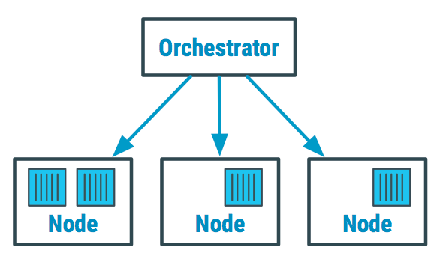
Orchestrator
manage and organize both hosts and docker containers running on a cluster
main issue - resource allocation - where can a container be scheduled, to fulfill its requirements (CPU/RAM/disk) + how to keep track of nodes and scale

Slide 24
Some orchestrator tasks
manage networking and access
track state of containers
scale services
do load balancing
relocation in case of unresponsive host
service discovery
attribute storage to containers
...

Slide 25

Orchestrator options
Kubernetes – open-source, product of CNCF
Apache Mesos – cluster management tool, with container orchestration being only one of the things it can do, originally through a plugin called Marathon
Docker Swarm – integrated in docker container platform

Slide 26
Comparison – ease of use
Kubernetes - fairly complex, steeper learning curve, web UI helps management + great API and documentation
Swarm - easy to pick up, comes already installed with docker
Mesos - trickiest to set up, requires specific plugin knowledge

Slide 27
Comparison – features and functionality - Kubernetes
most complete and fully integrated feature set
out of the box, comes with various features that are offered as add-ons for the others (auto-scaling, load balancing, etc)
customisable with controllers
supports different container runtimes
has evolved based on the Mesos experience and fixed most of the Mesos bugs and missing functionalities

Slide 28
Comparison – features and functionality - Swarm
can't compete feature-wise
out-of-the-box
requires third party tools for advanced configuration
faster deploy times

Slide 29
Comparison – features and functionality - Mesos
wider array of potential functionality
more mature software than all (as a whole)
Marathon first, but lacks features – persistent storage in particular
allows combination of containers with normal applications on the same cluster
some features hidden behind enterprise version

Slide 30
Comparison – scalability
Kubernetes - ability to easily schedule groups of complex applications, enabling scaling up to enterprise-level requirements
Swarm - better suited to small or medium clusters
Mesos - enables container orchestration on the largest scale

Slide 31
To sum up
entry level and testing - Swarm
enterprise-level - Kubernetes
more complex or large clusters - Mesos

Slide 32
Lately ...
Mesos announced Kubernetes support as container orchestration, alongside Marathon
Docker Enterprise Edition - integration with Kubernetes alongside Swarm
→ Kubernetes becoming the de-facto standard for container orchestration (allowing developers to focus on building on top instead of alternatives)

Slide 33
Kubernetes – What? Why? How?

Slide 34
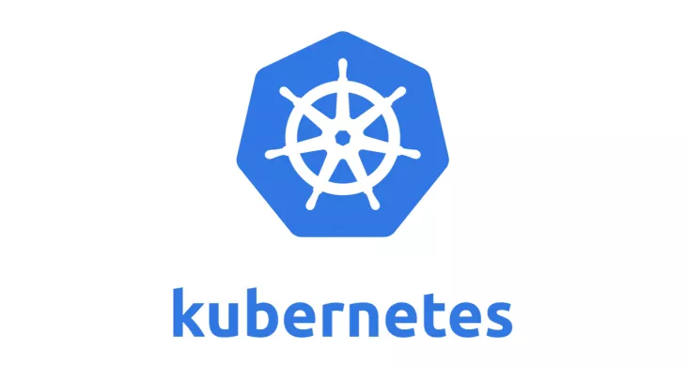
What is Kubernetes?
“Kubernetes” = Greek for governor, helmsman, captain
open-source container orchestration system
originally designed by Google, maintained by CNCF
aim to provide "platform for automating deployment, scaling and operations of application containers across clusters of hosts"

Slide 35
Why Kubernetes? - Goals
Main objectives, stated by devs, for community
Achieve velocity
Allow scaling of both software and teams
Present abstract infrastructure
Gain efficiency

Slide 36
Achieve velocity
Velocity = number of things you ship while maintaining a highly available service
Achieved by:
immutability - created artifact cannot be changed
declarative configuration - declare desired state and Kubernetes' job is to ensure it matches
self-healing systems - trying to maintain desired states if something changes

Slide 37
Allow scaling of software
encouraging decoupling in applications - separated components that communicate via defined APIs via load-balanced services
running in shared abstract environment, without interference
utilizing standard container format that runs on any machine

Slide 38
Allow scaling of teams
separation of concerns for consistency and scaling
application ops rely on the SLA provided by the platform
orchestrator ops uphold SLA

Slide 39
Present abstract infrastructure
decoupling container images and machines
cluster can be heterogenous and reduce overhead and cost
portability - container can be used on another cluster without being changed

Slide 40
Gain efficiency
optimized usage of physical machines - multiple containers on same machine
isolated with namespaces, to not interfere with each other

Slide 41
Computing Communication Coordination Application versioning Stateful

Slide 42
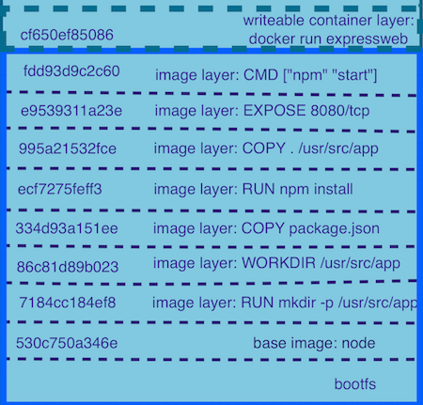
Container image format
layered format, allowing to inherit from lower levels and to modify them by adding, changing or removing files
using unified file system that allows this layering
issue – deleted file remains in older layers
image size bigger and build time longer -> development of better tools

Slide 43
Running a container
image provides the filesystem base for execution
configuration, to interoperate with the rest of the system – environment variables, CPU/RAM requirements, process to execute, ports to expose, etc.

Slide 44
Kubernetes and containers
Can you deploy a container in Kubernetes? NO (not directly)
Why not? Because the smallest deployable unit of computing is not a container, but ...

Slide 45
Pod
smallest deployable unit of computing in Kubernetes
colocated multiple apps(containers) into a single atomic unit, scheduled onto a single machine
upon creation, statically allocated to a certain node

Slide 46
Pod
each container runs in its own cgroup (CPU + RAM allocation), but they share some namespaces and filesystems, such as:
IP address and port space
same hostname
IPC channels for communication

Slide 47
So, why a pod and not container directly?
all or nothing approach for a group of symbiotic containers, that need to be kept together at all times
pod considered running if all containers are scheduled and running
Can you deploy a container in Kubernetes? Yes, inside a pod!

Slide 48
When to have multiple containers inside a pod?
when it's impossible for them to work on different machines (sharing local filesystem or using IPC)
when one of them facilitates communication with the other without altering it (adapter)
when one of them offers support for the other (logging/monitoring)
when one of them configures the other

Slide 49
Pod scheduling
scheduler tries to scatter replicas for reliability and are never moved (immutability)
what happens when physical node dies? pod needs to be deleted in order to be rescheduled

Slide 50
Pod health checks
process health check - main process is always running and has not exited (for each container)
liveness probe - application specific, determines if application actually does what the probe knows it should do
readiness probe - on start, it might take a while until the application fully loads and can process requests as expected

Slide 51
ConfigMaps and Secrets
configure pods, make images more reusable
live update on change (application needs to be able to reload)
secrets mounted as ram disk => not written to actual filesystem

Slide 52
Labels and annotations
labels - key/value pairs attached to objects arbitrarily, providing foundation for grouping objects
annotations - key/value pairs designed to hold non-identifying information that can be leveraged by tools and libraries
metadata needed by the system to provide identification, grouping and higher-level features

Slide 53
Computing Communication Coordination Application versioning Stateful

Slide 54
Communication challenges
between pods - using hardcoded IPs would be the wrong way to do it, as pods might be rescheduled on different nodes and change IPs
from outside - keep track of all pods that provide a certain service and loadbalance between them

Slide 55
Service discovery
find which processes are listening at which addresses for which services
do it quickly and reliably, with low-latency, storing richer definitions of what those services are
public DNS isn't dynamic enough to deal with the amount of updates

Slide 56
Service
abstraction which defines a logical set of Pods (selected using label selector), that provide the same functionality (same microservice)
different types, for different types of exposure provided by the service

Slide 57
ClusterIP Service
used for intra-cluster communication
special IP that will load-balance across all of the pods identified by service selector (which is a label selector)
allocated on create and cannot be changed until deletion of service, irrespective of number of pods

Slide 58
ClusterIP Service
internal Kubernetes DNS service allows service name to be used to access pods -
my-svc.my-namespace.svc.cluster.local
if using readiness probes, only ready pods will be loadbalanced

Slide 59
NodePorts Service
used to access pod from outside of cluster
system picks a port and on all cluster nodes, traffic on that port is sent to service to loadbalance to pods
external support needed to acces (ex - load-balanced DNS record with all cluster nodes)

Slide 60
LoadBalancer Service
implements the needed external support, to make access to pods easier in cloud environments
cloud providers provide support inside Kubernetes, to provision whatever is needed inside their environment to access service directly
Ex: IP gets allocated in Google, URL in AWS

Slide 61
Computing Communication Coordination Application versioning Stateful

Slide 62
Managing multiple pods
even though the pod is the building computing block for Kubernetes, working directly with Pods is tedious
Kubernetes abstracts different needs, to make it easier

Slide 63
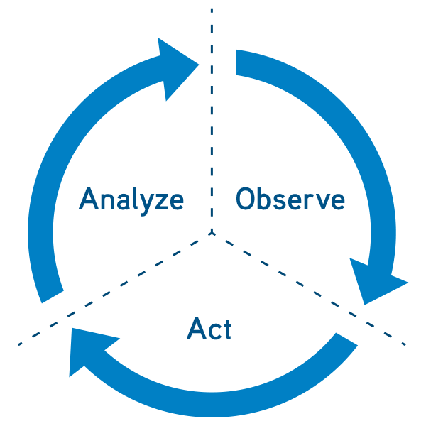
Reconciliation loop
start with a desired state
observe current state and take action to try to make it match the desired one
goal-driven, self-healing system

Slide 64
ReplicaSet
makes sure a given number of identical pods are up at any time
does not "own" the pods it manages - selected with labels
can adopt existing pods with those labels
quarantine containers - remove label!
by default, on delete it deletes the pods, but can be set not to (--cascade=false)

Slide 65
ReplicaSet
homogenous environment
designed for nearly stateless services
on shrink, the pod to be deleted is chosen arbitrarily
usage example – static web server

Slide 66
DaemonSet
makes sure a pod is executed on each physical node
usual usage - agent, logging, monitoring
can select nodes using node labels and node selector
can perform rollingUpdate on pods

Slide 67
Jobs
with ReplicaSets and DaemonSets, if pod's process exit (even with 0), it gets restarted, to keep consistency
Job manages Pods that need to run and exit with 0 (restarted until they do so)
configured with number of allowed parallel pods and number of expected completions

Slide 68
Job patterns
one shot - pods = 1, completion = 1
parallelism - pods >= 1, completion >= 1 (nr. pods will never be > completion)
work queue - pods >= 1, completion not set (pods will run until they all finish, no new ones created after one finishes)

Slide 69
Computing Communication Coordination Application versioning Stateful

Slide 70
Application versioning
there comes a time when a new version needs to be released
usually with no service downtime
check new version works before going through with the full release
Kubernetes has an abstraction for this!

Slide 71
Deployment
manages replica set through time and versions for pod spec
scale != version update
using health checks, makes sure a new version works
allows rollbacks to older versions (keeps track of changes)

Slide 72
Deployment strategies - recreate
all previous pods are destroyed and new pods are created
quickest
downtime while new pods start
in case of problems and rollback, even more downtime

Slide 73
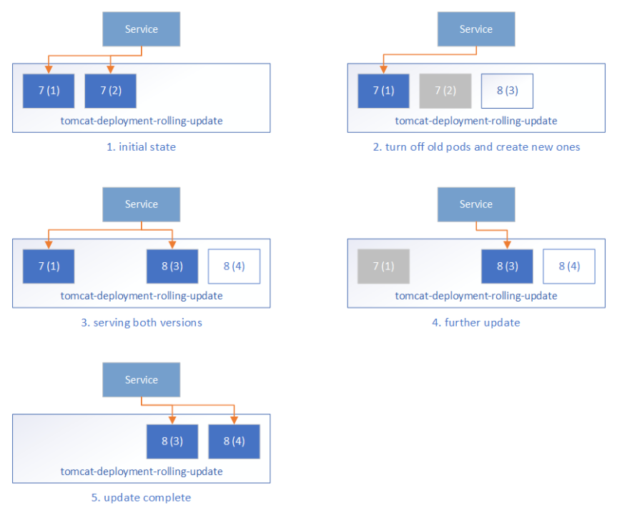
Deployment strategies – rolling update
configured with max unavailable and max surge
max unavailable = number of pods that can be doing updates/rollbacks at a time, from the number of replicas
max surge = number of additional pods to be used for update/rollback

Slide 74
Horizontal Pod Autoscaling
built-in feature
automatically shrink/increase based on certain parameters
works with heapster pod, that gathers information from containers
works on top of replicaSets as well as Deployments

Slide 75
Computing Communication Coordination Application versioning Stateful

Slide 76
stateless -> stateFULL
not all applications are stateless (most aren't)
state = unique pod identity (not interchange-able anymore) + persistence of data (even when rescheduled on different nodes)
Kubernetes comes to the rescue again!

Slide 77
StatefulSet
each replica gets a persistent hostname with unique id
created in order of index low -> high
delete in order of index high -> low
usage example - database

Slide 78
Headless service
no need for loadbalancing and a single service IP
service with clusterIP: none
used in order to create DNS records for replicas, which can be used to uniquely identify them (0.svc..., 1.svc...)

Slide 79
Persistence of data
how to define the physical location of data and how much should be allocated to each
how to actually allocate and link certain data to specific pods
abstracted and decoupled through PersistentVolume subsystem

Slide 80
PersistentVolume
abstraction of a piece of storage in the cluster that can be used
lifecycle independent of any individual pod that uses it
can be manually put by an operator or can be provisioned dynamically (usually in cloud services)

Slide 81
PersistentVolumeClaim
request for storage by an user
storage equivalent of a pod
links a persistent volume to a pod for the pod's lifetime
doesn't affect the persistent volume upon pod deletion (unless explicitly specified)

Slide 82
Wrap-up
computing building block = Pod
communication building block = Service
grouping = Labels and Annotations
configuration = ConfigMap and Secrets
stateless pod coordination = ReplicaSet, DaemonSet, Job
application updates = Deployment
stateful pod coordination = StatefulSet
storage building block = PersistentVolumeClaim on top of PersistentVolume

Slide 83
Extending Kubernetes

Slide 84
Soooo many things to configure :(
at least one controller
some services
some configMaps and Secrets
preallocate persistentVolumes or create storage class for dynamic provisioning

Slide 85
Solution: another level of abstraction
higher-level controller that can manage lower-level elements
for the moment, not included in Kubernetes ... YET!
BUT can be added, through third-party controllers

Slide 86

What is Helm?
package manager for Kubernetes
provides higher-level abstraction (Chart) to configure full-fledged applications
manage complexity, easy upgrades, simple sharing of full application setups, safe rollbacks

Slide 87
How does Helm work?
Helm CLI + Tiller server in Kubernetes (which is a controller)
CLI responsible for management + requests for releases of charts on Kubernetes
Tiller - listens for requests, combines chart + configuration = release, install release, track release

Slide 88
Helm++
Helm release controller - current Lentiq way to manage applications
expose HelmRelease as a CRD (custom resource definition) in Kubernetes, to work directly with Kubernetes to manage apps

Slide 89
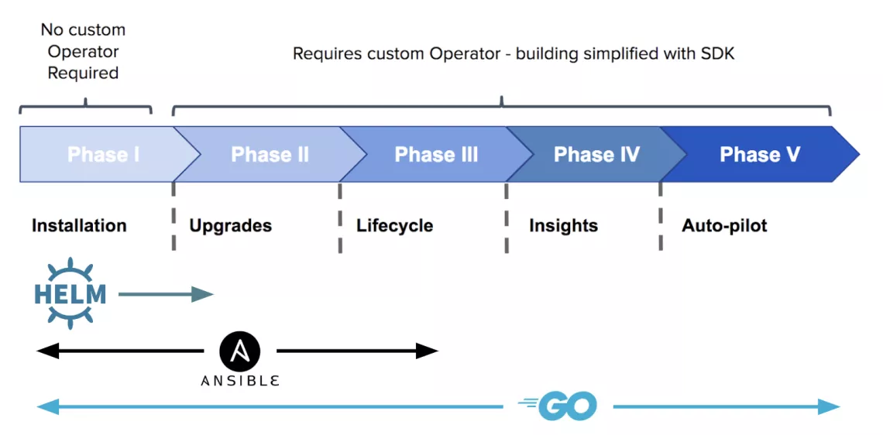
What are Operators?
domain-specific controller
manages lifetime of a single application
works with Kubernetes primitives, as well as performing application-specific steps

Slide 90
Operators
pre and post provision hooks, for application-specific operations
single tool to perform all management (kubectl)
work in a scalable, repeatable, standard fashion
improve resiliency while reducing burden on IT teams

Slide 91
Operator framework
open-source toolkit to manage Kubernetes native applications
provides ways to implement Operators
multiple companies adopted and implemented Operators for their software, to provide the quickest start

Slide 92
Operator gallery
https://github.com/operator-framework/awesome-operators
Spark
Kafka
Cassandra
MongoDB
MySQL
Airflow

Slide 93
Kubernetes and Big Data

Slide 94
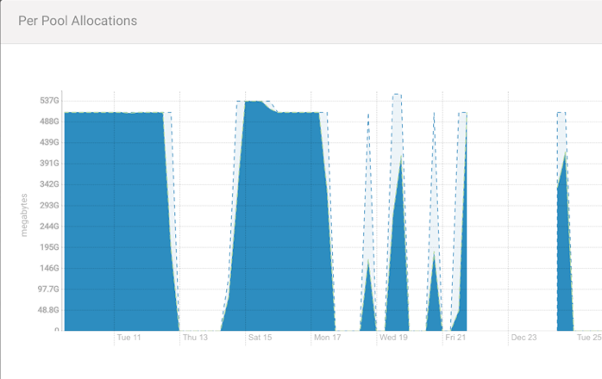
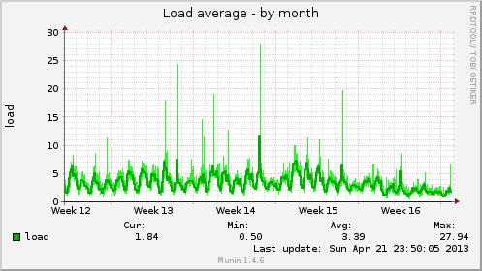
Usual workload
bursts of 100% utilization, followed by zero
→ quick startup times + scaling capabilities helps to properly scale and use cluster efficiently

Slide 95
Vs Hadoop distributions
can run any workload (vs supported apps)
smaller footprint
robust
no vendor lock-in
cloud native
designed for self-service

Slide 96
Effects
fewer ops people needed (but more highly qualified), but with no domain specific knowledge (remember decoupling?)
higher abstraction level => focus on how to use the software and not how to set it up
shift more to cloud

Slide 97
Why cloud?
use Kubernetes offered as managed service
on demand use, due to quickness of setup of cluster + applications
benefit from cloud scaling, if needed

Slide 98
Demo

Slide 99
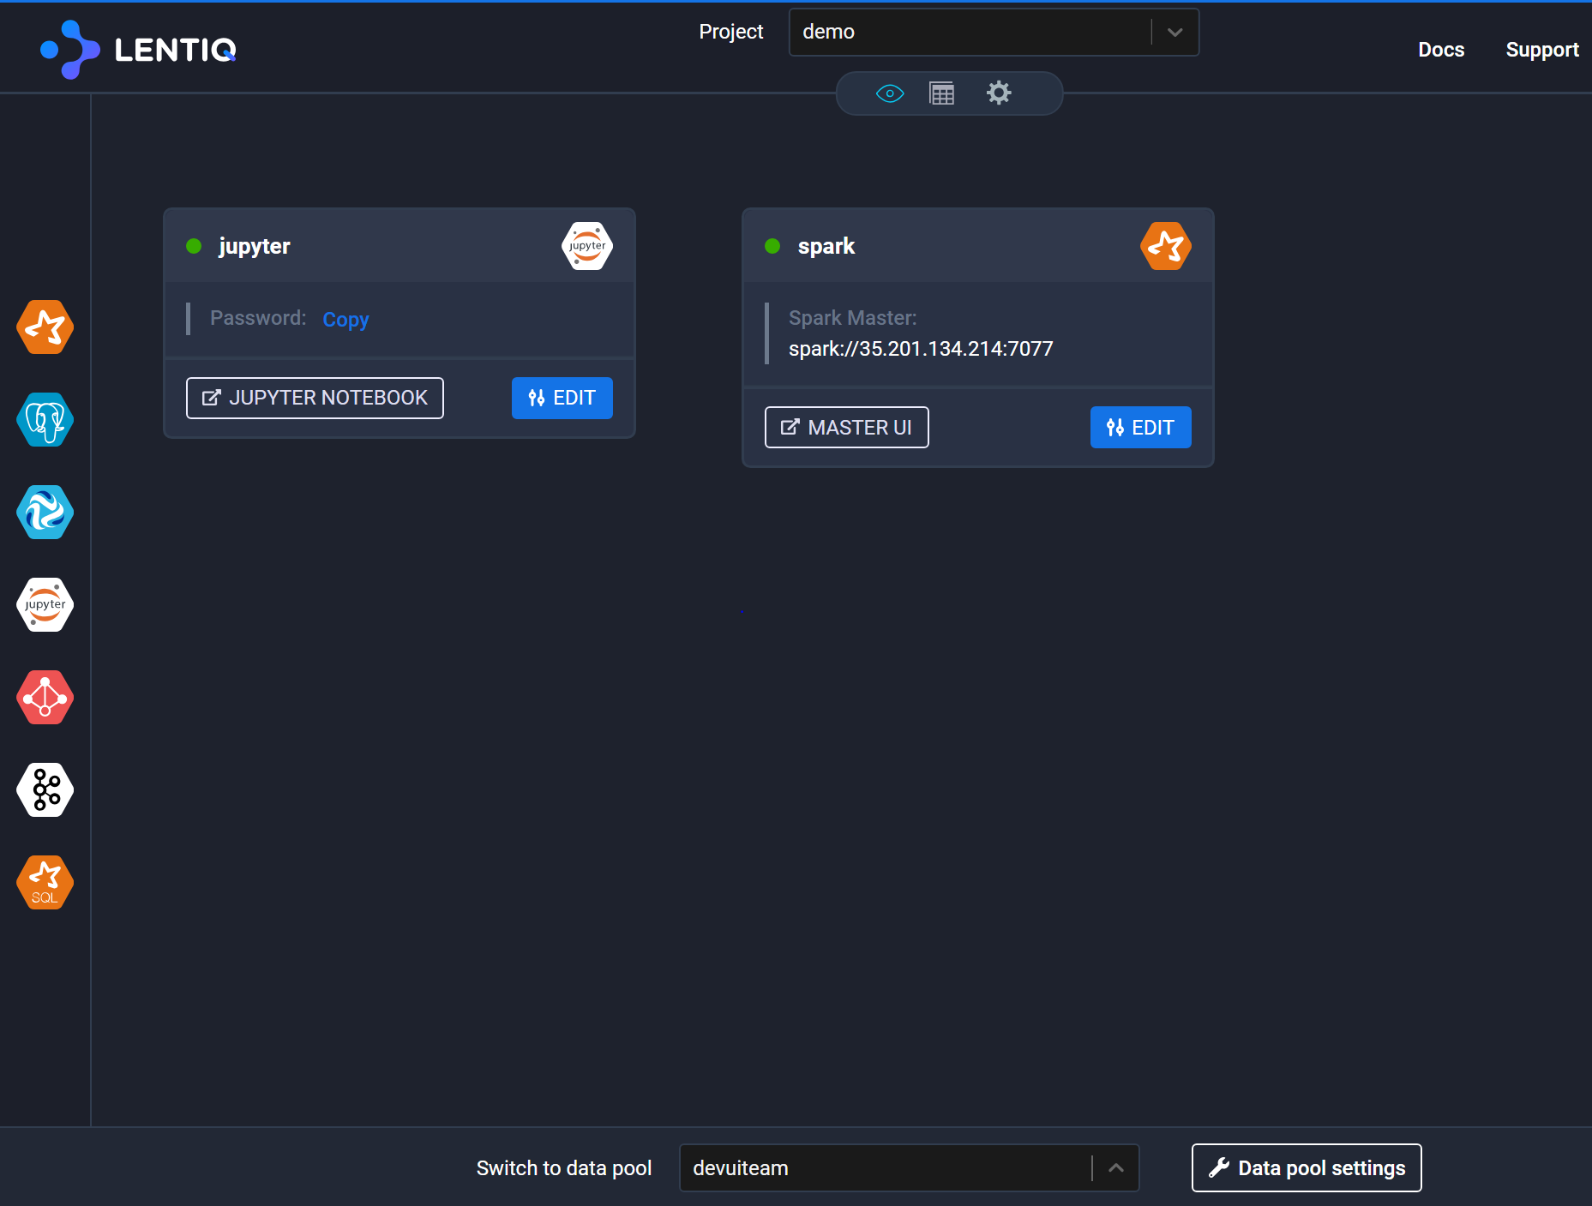
APPS CREATED FROM INTERFACE

Slide 100
APPS CREATED FROM INTERFACE
user@cloudshell:~ (demo)$ kubectl get helmreleases --namespace=demo
NAME AGE
internal-sparksql 24m
jupyter 17m
spark 12m
user@cloudshell:~ (demo)$ kubectl get statefulsets --namespace=demo
NAME DESIRED CURRENT AGE
demo-internal-sparksql-bdl-sparksql-master 1 1 24m
demo-internal-sparksql-bdl-sparksql-worker 1 1 24m
demo-jupyter-bdl-jupyter 1 1 17m
demo-spark-bdl-spark-master 1 1 13m
demo-spark-bdl-spark-worker 1 1 13m
user@cloudshell:~ (demo)$ kubectl get pods --namespace=demo
NAME READY STATUS RESTARTS AGE
demo-internal-sparksql-bdl-sparksql-master-0 2/2 Running 2 24m
demo-internal-sparksql-bdl-sparksql-worker-0 1/1 Running 0 24m
demo-jupyter-bdl-jupyter-0 1/1 Running 0 18m
demo-spark-bdl-spark-master-0 2/2 Running 0 13m
demo-spark-bdl-spark-worker-0 1/1 Running 0 13m

Slide 101
APPS CREATED FROM INTERFACE
user@cloudshell:~ (demo)$ kubectl get services --namespace=demo
NAME TYPE CLUSTER-IP EXTERNAL-IP PORT(S) AGE
demo-internal-sparksql-bdl-sparksql-master ClusterIP None <none> 4040/TCP,8080/TCP,7077/TCP,10000/TCP 24m
demo-internal-sparksql-bdl-sparksql-master-public LoadBalancer 10.31.252.242 34.80.170.123 80:32438/TCP,4040:30330/TCP,7077:30605/TCP,10000:32755/TCP 24m
demo-internal-sparksql-bdl-sparksql-worker ClusterIP None <none> 8081/TCP 24m
demo-internal-sparksql-bdl-sparksql-worker-public LoadBalancer 10.31.254.85 34.80.191.210 8081:32181/TCP 24m
demo-jupyter-bdl-jupyter ClusterIP None <none> 8888/TCP 18m
demo-jupyter-bdl-jupyter-public LoadBalancer 10.31.253.99 34.80.208.250 8888:30753/TCP 18m
demo-spark-bdl-spark-master ClusterIP None <none> 4040/TCP,8080/TCP,7077/TCP 13m
demo-spark-bdl-spark-master-public LoadBalancer 10.31.249.147 35.201.134.214 80:31575/TCP,4040:32010/TCP,7077:30910/TCP 13m
demo-spark-bdl-spark-worker ClusterIP None <none> 8081/TCP 13m
demo-spark-bdl-spark-worker-public LoadBalancer 10.31.243.213 35.201.202.111 8081:31535/TCP 13m
user@cloudshell:~ (demo)$ kubectl get pvc --namespace=demo
NAME STATUS VOLUME CAPACITY ACCESS MODES STORAGECLASS AGE
data-demo-internal-sparksql-bdl-sparksql-master-0 Bound pvc-f37593fa-43e4-11e9-90c0-42010a8c0026 15Gi RWO standard 1h
data-demo-internal-sparksql-bdl-sparksql-worker-0 Bound pvc-f376aa77-43e4-11e9-90c0-42010a8c0026 15Gi RWO standard 1h
data-demo-jupyter-bdl-jupyter Bound pvc-d9e302f5-43e5-11e9-90c0-42010a8c0026 15Gi RWO standard 1h
data-demo-spark-bdl-spark-master-0 Bound pvc-7e301d28-43e6-11e9-90c0-42010a8c0026 15Gi RWO standard 1h
data-demo-spark-bdl-spark-worker-0 Bound pvc-7e314394-43e6-11e9-90c0-42010a8c0026 15Gi RWO standard 1h

Slide 102
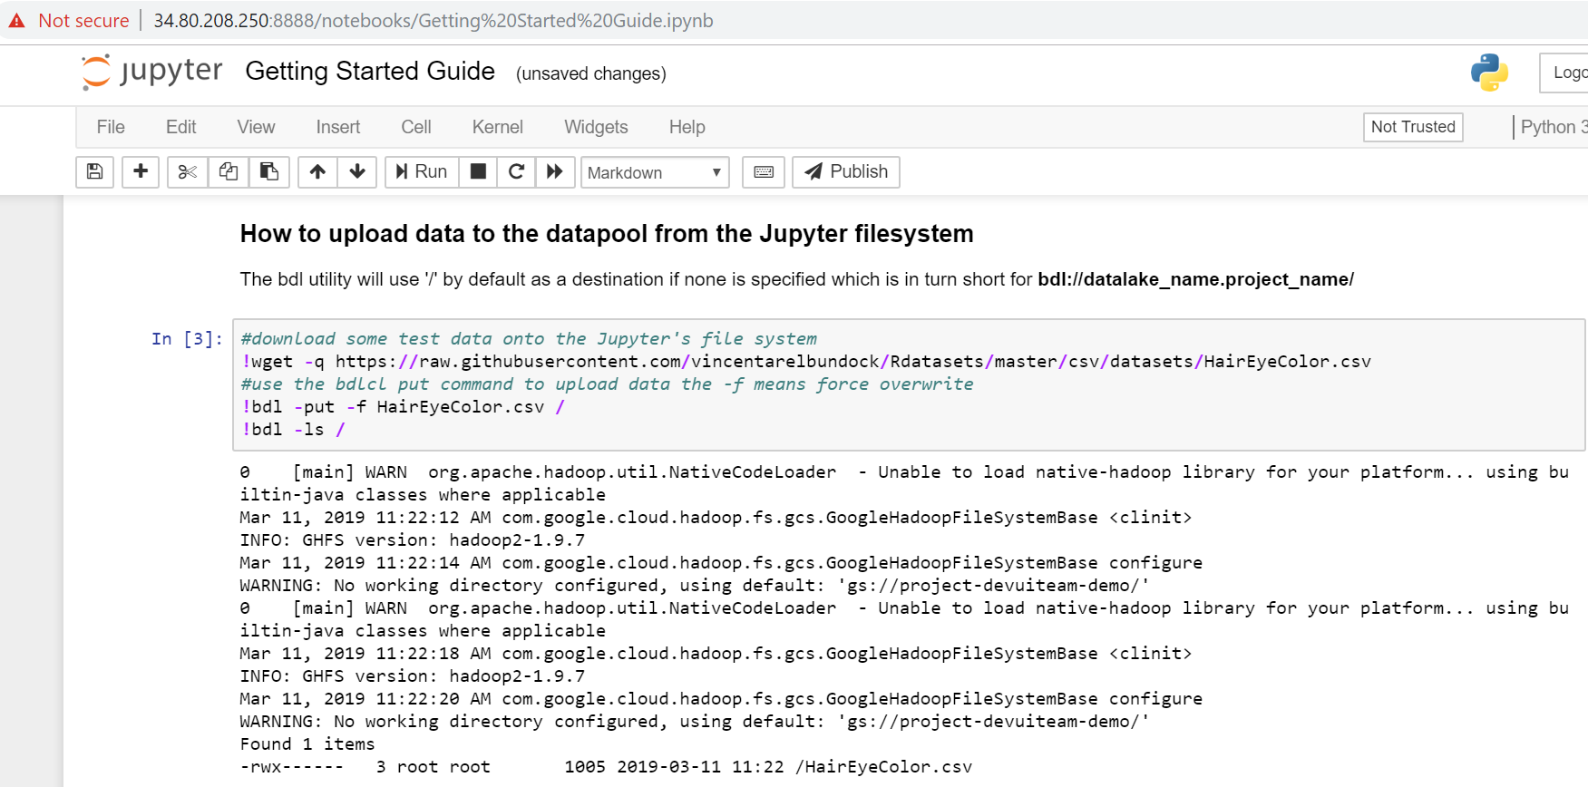
UPLOAD DATA VIA JUPYTER

Slide 103
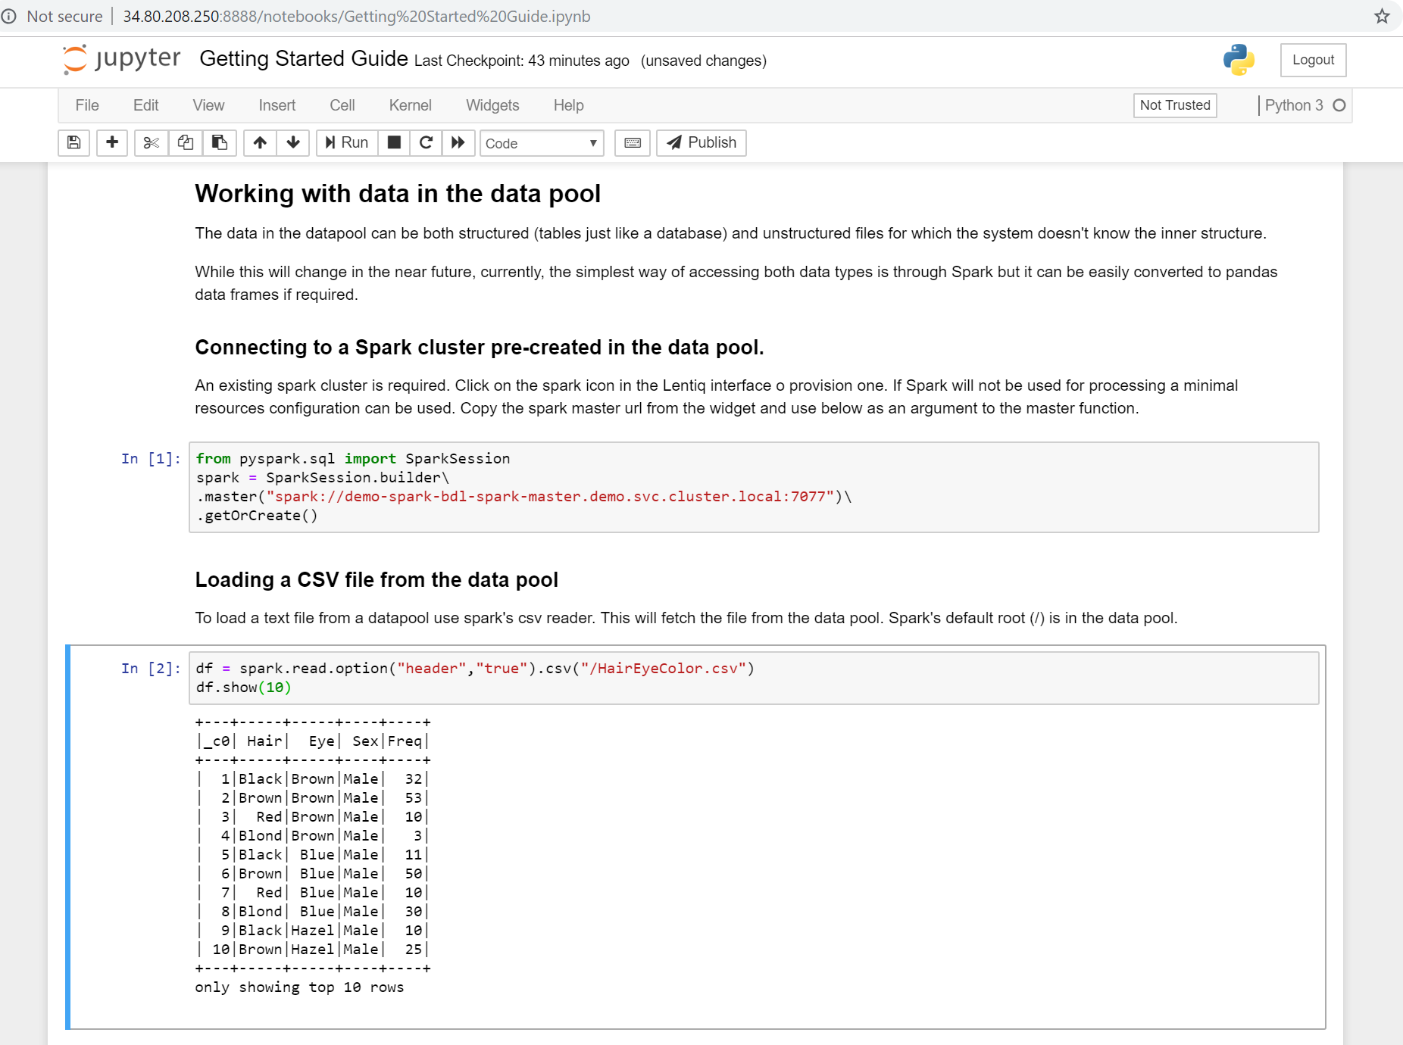
CONNECT TO SPARK AND RUN QUERY

Slide 104
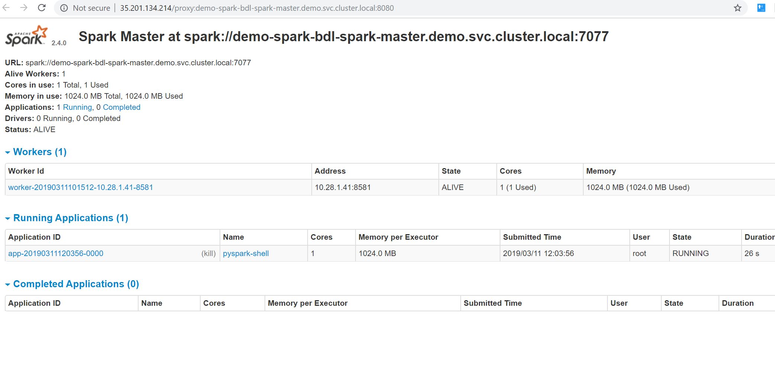
SPARK UI SHOWS CONNECTION FROM JUPYTER

Slide 105
Q&A
Test how apps work on Kubernetes (and more), by testing EdgeLake @ datalake.lentiq.com

Slide 106
Text resources
https://techcrunch.com/2016/10/16/wtf-is-a-container/
https://linuxacademy.com/blog/containers/history-of-container-technology/
https://jpetazzo.github.io/2017/02/24/from-dotcloud-to-docker/
https://www.fasthosts.co.uk/blog/cloud/kubernetes-vs-docker-swarm-vs-apache-mesos
https://www.infoq.com/presentations/kubernetes-stateful-containers
“Kubernetes Up & Running” - Brendan Burns, Kelsey Hightower & Joe Beda
“Mastering Kubernetes” - Gigi Sayfan

Slide 107
Image resources
[1] https://rominirani.com/learning-docker-move-to-the-cloud-3326369300ad
[2] https://docs.docker.com/get-started/
[3] https://www.n-ix.com/microservices-vs-monolith-which-architecture-best-choice-your-business/
[4] https://thenewstack.io/happens-use-java-1960-ibm-mainframe/
[5] https://blog.docker.com/2017/10/least-privilege-container-orchestration/
[6] https://rancher.com/comparing-rancher-orchestration-engine-options/
[7] https://softwareengineeringdaily.com/2019/01/11/why-is-storage-on-kubernetes-is-so-hard/
[8] https://medium.com/@jessgreb01/digging-into-docker-layers-c22f948ed612
[9] https://www.bluedata.com/blog/2018/07/operation-stateful-bluek8s-and-kubernetes-director/kubernetes-reconciliation-loop/
[10] https://kubernetes.io/blog/2018/04/30/zero-downtime-deployment-kubernetes-jenkins/
[11] https://github.com/helm/helm
[12] https://blog.openshift.com/make-a-kubernetes-operator-in-15-minutes-with-helm/

